Slide 1



UBS Challenge 2024
Financial Data Engineers 2 风险预警师
UBS Challenge 2024
Financial Data Engineers 2 风险预警师
Feiyang Xu, University of Amsterdam, BSc EBE, 2026
Haoyang Wang, University of Amsterdam, BSc EBE, 2026
Joshua Juan Yin Chan, Nanyang Technological University, PhD Mathematics, 2028
Feiyang Xu, University of Amsterdam, BSc EBE, 2026
Haoyang Wang, University of Amsterdam, BSc EBE, 2026
Joshua Juan Yin Chan, Nanyang Technological University, PhD Mathematics, 2028

Slide 2
Data Preprocessing
1
Classification
2
Assumption
We assume if a product has Start Date minus Date equals approximately 10y, then it falls into the
Expiry 10y Bucket.
Expiry
Same set of terms in common
(10y, 15y…)
Expiry Date
Start Date
2 Business Days
Tenor
Select rows of swap rate and vols where the Expiry and the Tenor are having a same term
Selection of Dummy Trade
Volatility of Strike
TVs and Vegas by Zero Rate Shocks
List the Vols for each row of data under different strikes
Select each Dummy Trade with Expiry and Tenor has a same term while considered of trade Vegas
List TVs and Vegas based on different Zero Rate Shocks

Slide 3
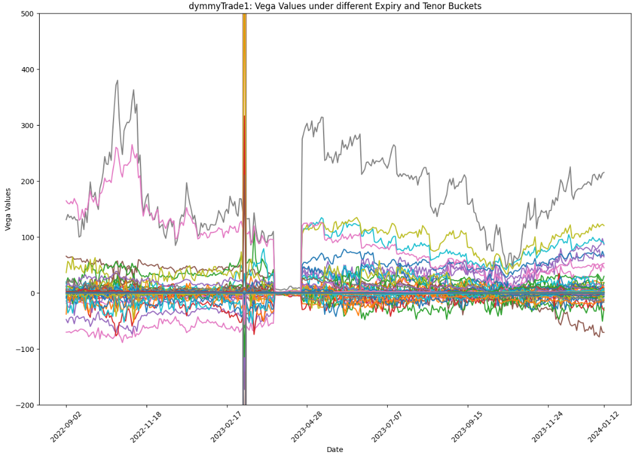
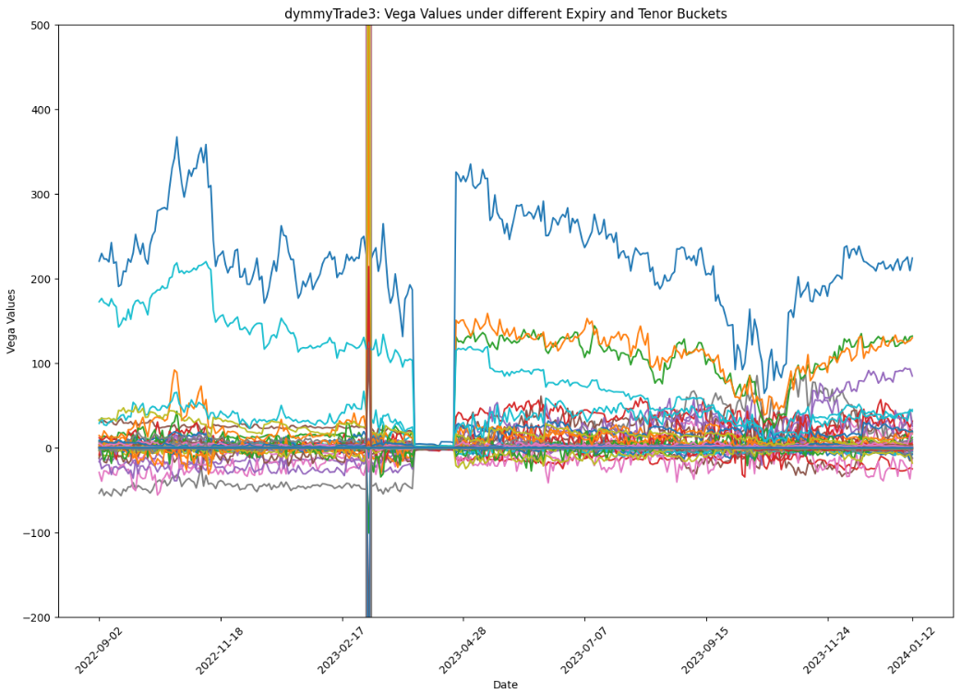
Data Observation - Historical Risk Factor Data
dummyTrade1: Vega Values under different Expiry and Tenor Buckets
dummyTrade3: Vega Values under different Expiry and Tenor Buckets
Through the analysis of Vega values under different Expiry and Tenor Buckets for dummyTrade1 and 3, we found the following:
- 09/2022-02/2023 and 04/2023-02/2024: Vega values experienced significant fluctuations, with an overall trend of decreasing and then rebounding.
- During the observation period, there is an extremly high value on 21st Feb. 2023, but we do not consider it an outlier that can be excluded; instead, we identify it as a ‘Black Swan event’ that should be included in our analysis.
- In March 2023, Vega values were very closed to 0 – also an unusual pattern compared to data in other timing. We call it as ‘unusual tranquility’.
Note that when tenor is 18M, vega is always 0.

Slide 4
Developing a Strategy for Data Analysis Based on Observed Data Trend
The ‘Black Swan event’ on 21st Feb. 2023 and the ‘unusual tranquility’ in March 2023 motivates us to develop a 2-way strategy in making predictions for future Vega values.
In essence, we want a comprehensive strategy that is able to
Identify moments of unusual events, such as ‘Black Swan event’ and ‘unusual tranquility’
Where Vega is not unusually behaving, give a precise estimate on future Vega value
1
Classification: Categorising Vega into 3 risk buckets and predicting the risk bucket of Vega
Pros: - Offers the important information of whether the predicted future Vega will be ‘extreme high risk’
- This information can help us decide which trading strategy to adopt
Cons: - When future Vega is well-behaved (stable, no shock), then it doesn’t offer a precise prediction
2
Regression: Computing a precise numerical estimate of future Vega
Pros: - It offers a precise numerical estimate on future Vega value for developing trade strategies
- When Vega is stable, its predicted future value will also be stable
Cons: - When there is market shock, e.g., market crashes and Vega value becomes very large, then its prediction wouldn’t be precise and accurate
In actual practice, the trading algorithm will start from deciding whether the Vega risk is ‘extreme high risk’, ‘high risk’ or ‘low risk’ to decide which trading strategy to adopt; once decided on the strategy, it will then input the precise numerical estimates on future Vega value as parameter to the model. So the algorithm starts from Method 1 then Method 2.

Slide 5
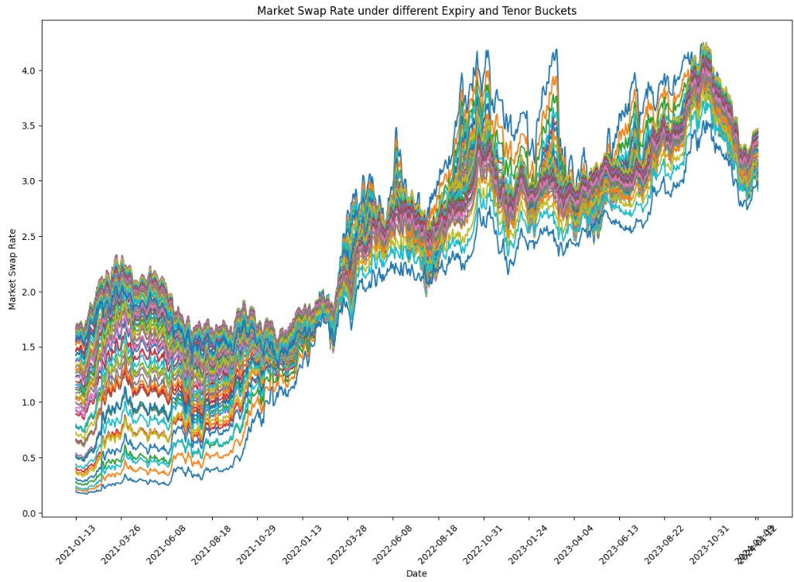
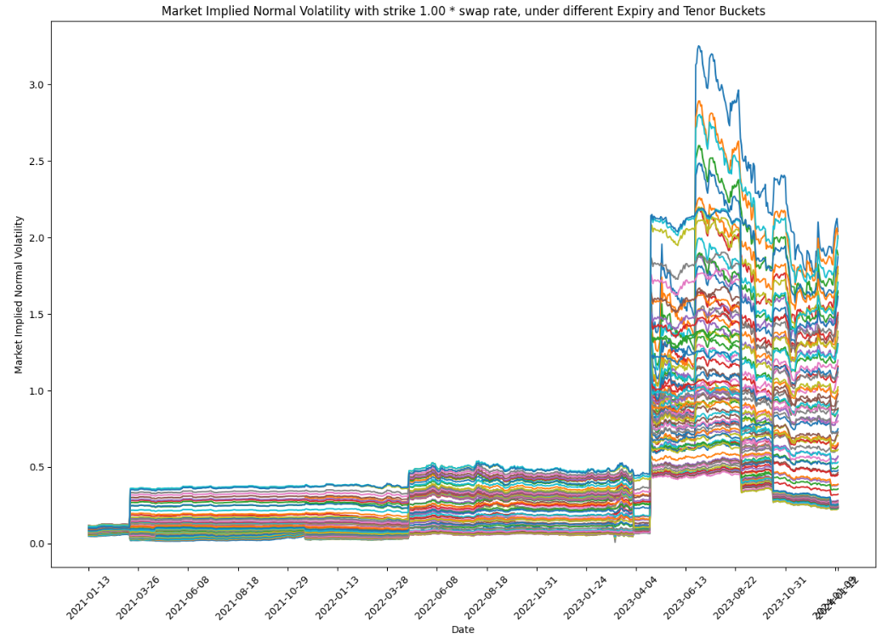

Data Observation - Market Environment
Market Swap Rate under different Expiry and Tenor Buckets
Market lmplied Normal Volatility with strike 1.00 * swap rate, under diferent Expiry and Tenor Buckets
Market Swap Rate
Market Implied Normal Volatility
Overall Trend: The market swap rate shows a significant upward trend over the entire period.
Volatility: The swap rate exhibits varying degrees of volatility. From Jan. 2022 to Jan. 2024, volatility is high, indicating strong market instability.
Stability Periods:
2021/01/13 to 2021/03/28: Stable period
2022/03/28 to 2023/04/04: Slight upward stability
Volatility Periods:
After 2023/04/04: Significant increase and continued volatility

Slide 6
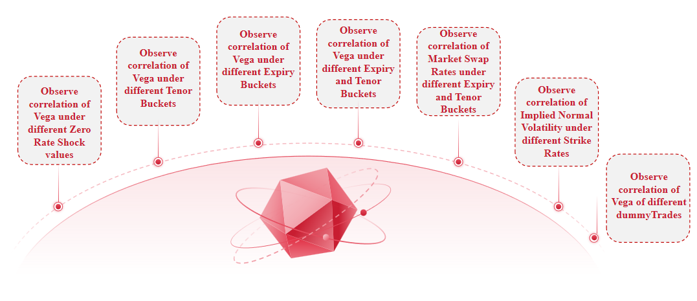
Correlation
Note that we have considered correlations from the following seven dimensions. To simplify, we will demonstrate using only one of them.

Slide 7
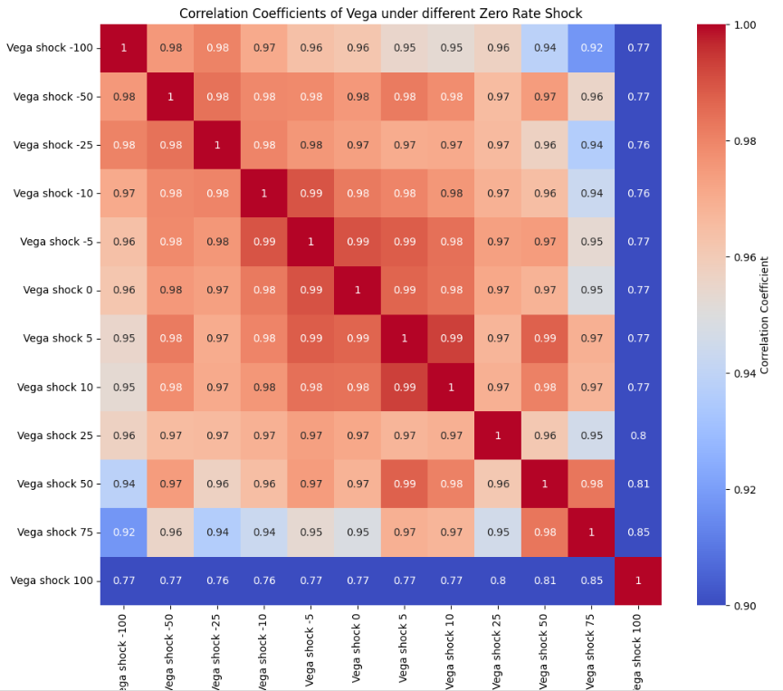
Correlation - Observe Correlation of Vega under Different Zero Rate Shock Values
Choosing the Number of Risk Buckets
Observation
Overall trend: Most of the correlations between Vega shocks are high, especially in the range of -100 to 25, indicating that within this range of shocks, the changes in Vega values tend to be consistent.
Simplification Strategy
Due to the strong correlations among these variables, we can select one variable to represent all the others.
Representative Products
We select the product ‘dummyTrade1 Expiry 3y Tenor 3y’ and ‘dummyTrade1 Expiry 3y Tenor 4y’ as the representative products because:
- They have the highest correlation with other products
- Both products are negatively correlated with each other (correlation -1), meaningful to observe trend.

Slide 8
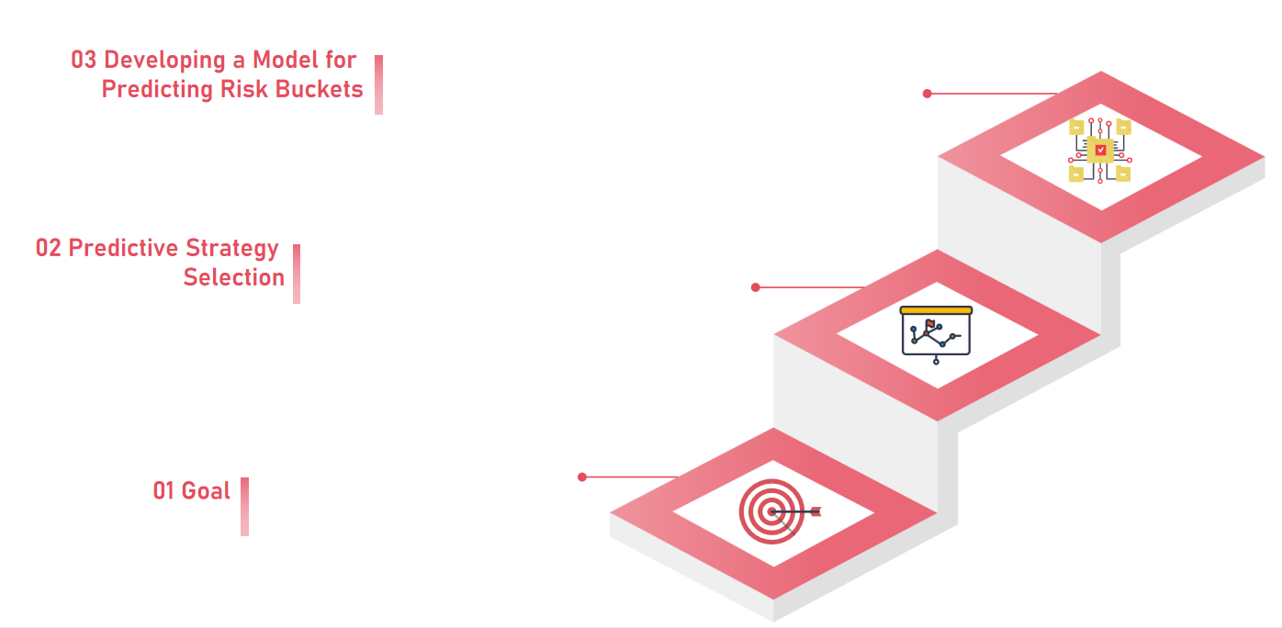
XGBoost Model Prediction, Product: Expiry 3y Tenor 3y
Classification: To obtain the risk buckets, we first need to answer the following questions:
• How many risk buckets do we want to categorise the data into?
• How to define the range (max, min) of the risk buckets?
Two Strategies
• Classification: predicting risk bucket for 'Vega MA t+1 to t+5'
• Regression: computing a numerical estimate for 'Vega MA t+1 to t+5'
Now we start with developing a model to predict the risk bucket.
Predicting 'Vega MA t+1 to t+5' (MA = Moving Average)

Slide 9
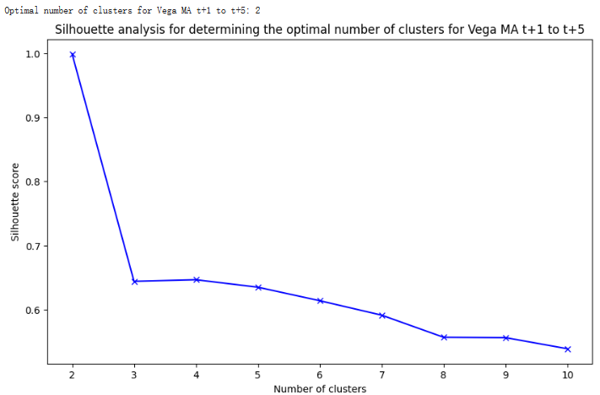
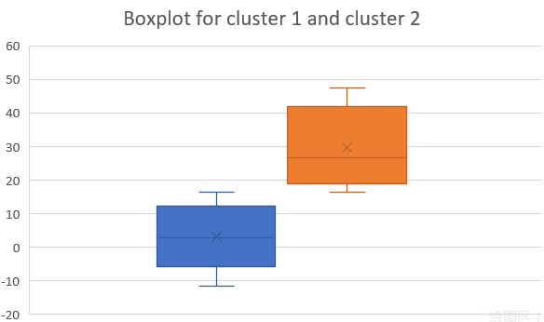
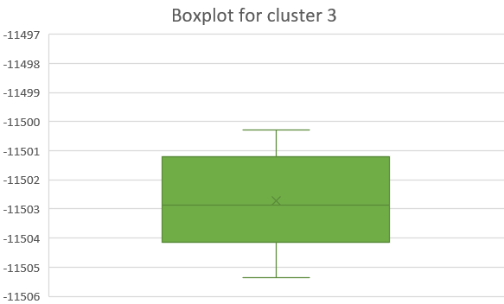
XGBoost - Classification; Product: Expiry 3y Tenor 3y
Tenor
Tenor
Tenor
Choosing the Number of Risk Buckets
Based on the Silhouette Analysis graph for 'Vega MA t+1 to t+5', we see that the optimal number of clusters is 2.
However, using 2 buckets would only allow us to observe whether the future Vega is extremely high risk or not extremely high risk. Conversely, using more buckets (e.g., 4 or more) results in decreased model accuracy, with many false positives and false negatives. Therefore, we decided to use 3 risk buckets.
kNN analysis to determine the ranges
The ranges for risk buckets 1 to 3 are shown in the right-hand graph.
We name the 3 buckets as 'low risk' (class 1), 'high risk' (class 2), and 'extreme high risk' (class 3)
Note that we also classify 'Vega MA t-59 to t-30', 'Vega MA t-29 to t-15', 'Vega MA t-14 to t-10', 'Vega MA t-9 to t-5', 'Vega MA t-4 to t' into 3 risk buckets using kNN analysis.

Slide 10
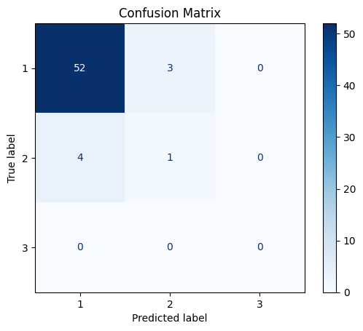
XGBoost - Classification; Product: Expiry 3y Tenor 3y
1
Classification by using XGBoost
Class 1
Low Risk
Ture Positive = 52
Total:
331 data of “Vega MA t+1 to t+5”
Class 2
High Risk
Ture Positive = 1
Training Data: First 271 Data
Backtesting Data: Last 60 Data
Class 3
Extreme High Risk
Ture Positive = 0
Confusion Matrix
Accuracy = 0.88
Strong performance for Low Risk
With 52 true positives, 4 false negatives, and 3 false positives
Poor performance for High Risk
Only 1 true positives, 4 false positives
No performance for Extreme High Risk

Slide 11
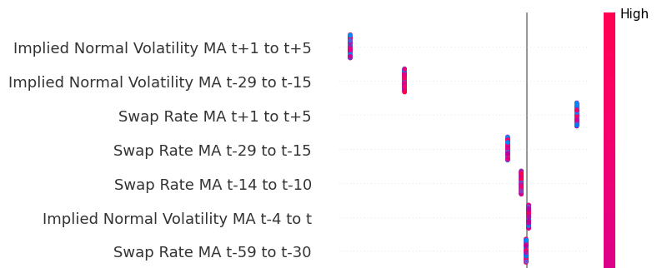
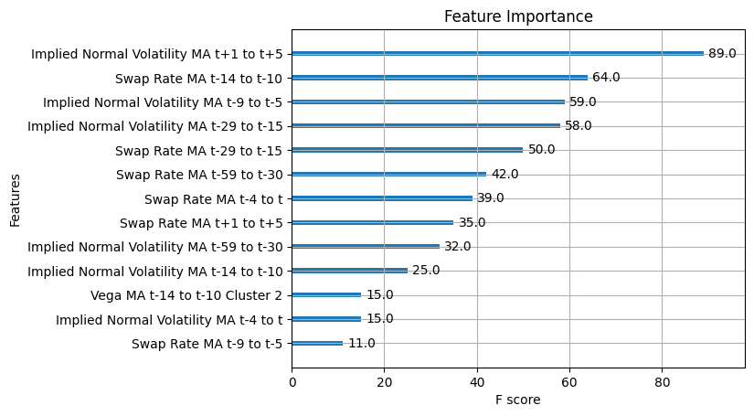
XGBoost - Classification; Product: Expiry 3y Tenor 3y
2
Feature Importance
For Class 3, Extreme High Risk
The model relies heavily on the feature related to implied volatility and swap rates
1. Implied Normal Volatility MA t+1 to t+5 (and t-29 to t-15)
Points are highly concentrated on the left side, showing a significant negative impact on the model's predictions. The distribution of colors suggests both high and low values affect the model
2. Swap Rate MA t+1 to t+5
Points are concentrated on the right side, showing a clear positive influence on the model's predictions. High values indicate stronger influence
Feature Value
SHAP value (Impact on model output)
The most important feature:
Implied Normal Volatility MA t+1 to t+5
Second important feature:
Swap Rate MA t-14 to t-10
The consistent importance of implied normal volatility and swap rate features across different time frames indicates that upcoming and historical trends are essential for the model's decision-making process

Slide 12
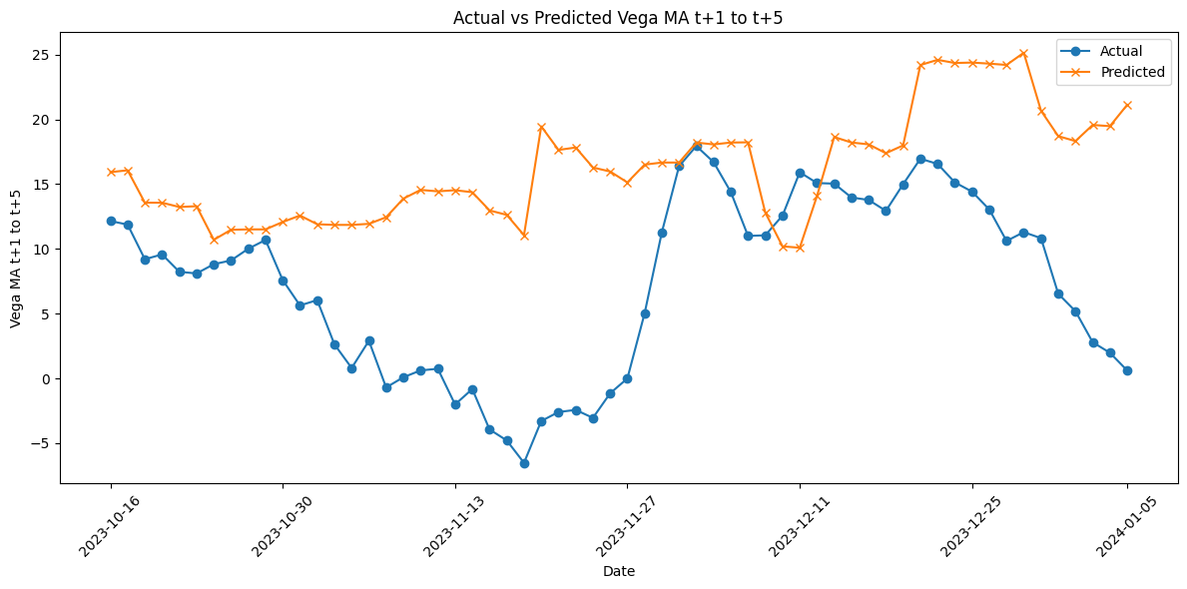
XGBoost - Regression; Product: Expiry 3y Tenor 3y
3
Regression by XGBoost
Actual value: Actual values show a downward trend from mid-Oct 2023 to mid-Nov 2023, reaching a low in late November
There was a clear peak in real terms at the end of Nov 2023, followed by fluctuations and a downward trend in Dec 2023 and early Jan 2024 again
Predicted value:
The forecast values are generally higher than the actual values throughout the period. They are also less volatile and have relatively smooth lines
Although the overall trend direction of the actual and predicted values is roughly the same, the forecasted values are consistently higher than the actual values
This suggests that the prediction model may have a tendency to favor higher Vega values or may be overestimating risks

Slide 13
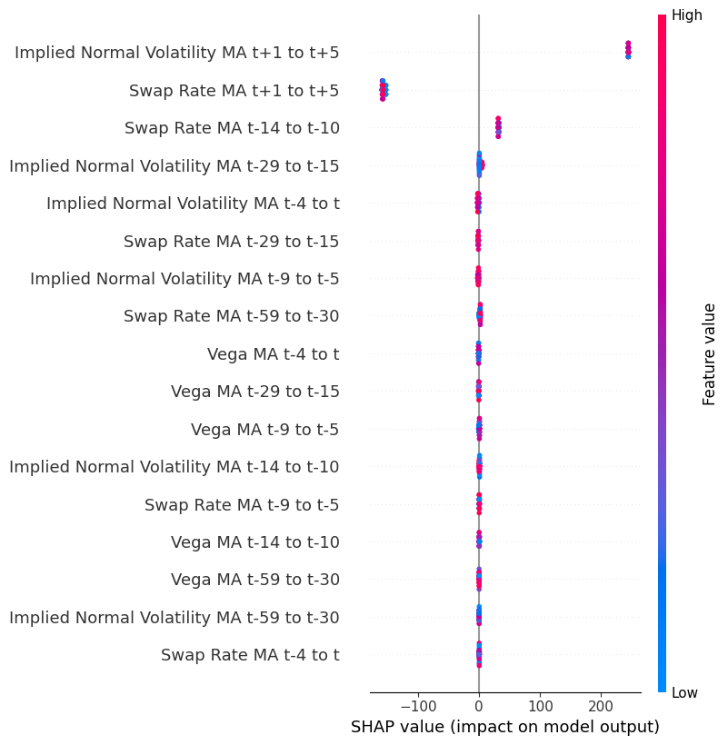
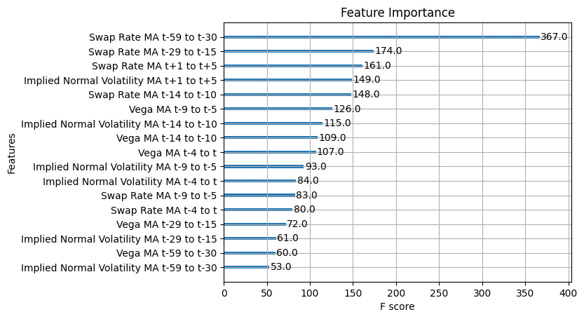
XGBoost - Regression; Product: Expiry 3y Tenor 3y
Total:
331 data of “Vega MA t+1 to t+5”
Training Data: First 271 Data
Backtesting Data: Last 60 Data
(Same as Classification)
All X-variables remain as real number, not classified into different clusters
The diagram of feature importance highlights the significant importance of Swap Rate MA t-59 to t-30 in the model's predictions
As the first three features are all Swap Rates, they consistently demonstrate the critical role of historical swap rate data in shaping the model's outcomes and emphasizing the importance of monitoring swap rate trends for accurate predictions
Mean Squared Error
Mean Absolute Error
Implied Normal Volatility MA t+1 to t+5 shows it has a strong positive impact on model’s prediction
Swap Rate MA t+1 to t+5 suggests a strong negative influence on prediction
124.69
9.27

Slide 14
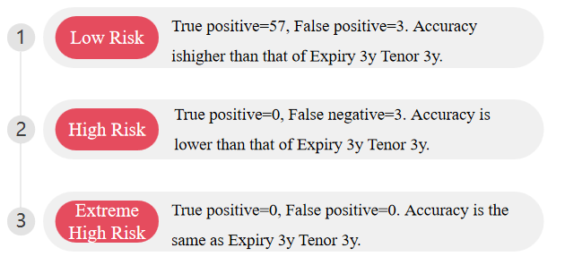
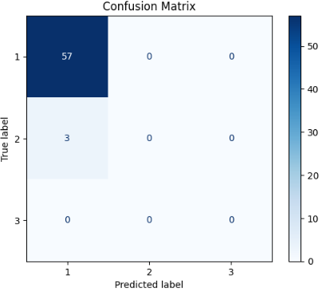
XGBoost - Classification; Product: Expiry 3y Tenor 4y
Note that we consider another product because in "Storyline_2_Observation_and_Correlation.ipynb" we found that the Vega of Expiry 3y Tenor 3y is negatively correlated with the Vega of Expiry 3y Tenor 4y.
1
Classification by using XGBoost
Accuracy = 0.95, higher than that of Expiry 3y Tenor 3y

Slide 15
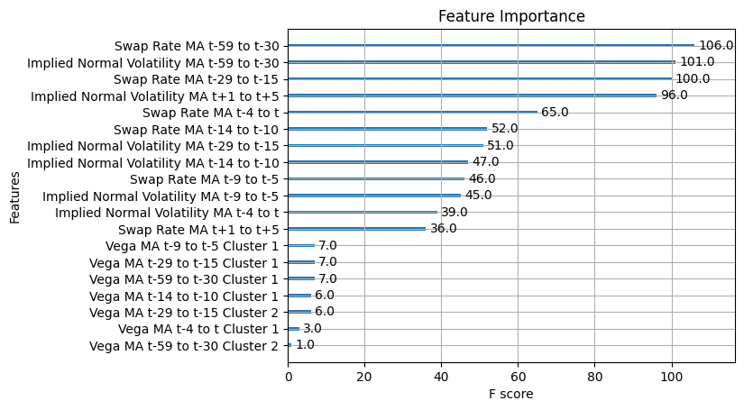
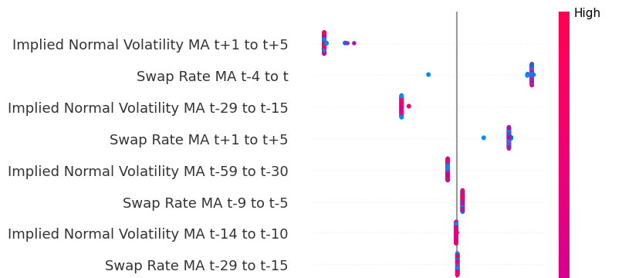
XGBoost - Classification; Product: Expiry 3y Tenor 4y
2
Feature Importance
 | Expiry 3y Tenor 3y | Expiry 3y Tenor 4y
Most important feature | Implied Normal Volatility MA t+1 to t+5 | Swap Rate MA t-59 to t-30
Second most important feature | Swap Rate MA t-14 to t-10 | Implied Normal Volatility MA t-59 to t-30
Market Swap Rates and Implied Normal Volatility remain as crucial factors
For Class 3, Extreme High Risk
Same set of market parameters also give rise to equivalent degree of +/- impact on model’s prediction
1. Implied Normal Volatility MA t+1 to t+5 (and t-29 to t-15)
Compared to Expiry 3y Tenor 3y, for Expiry 3y Tenor 4y these two parameters are also exhibiting significant negative impact on the model's predictions. The distribution of colors suggests both high and low values affect the model
2. Swap Rate MA t-4 to 4 (and t+1 to t+5)
Same as Expiry 3y Tenor 3y, these two market Swap Rate parameters also exhibit clear positive influence on the model's predictions. High values indicate stronger influence
SHAP value (Impact on model output)

Slide 16
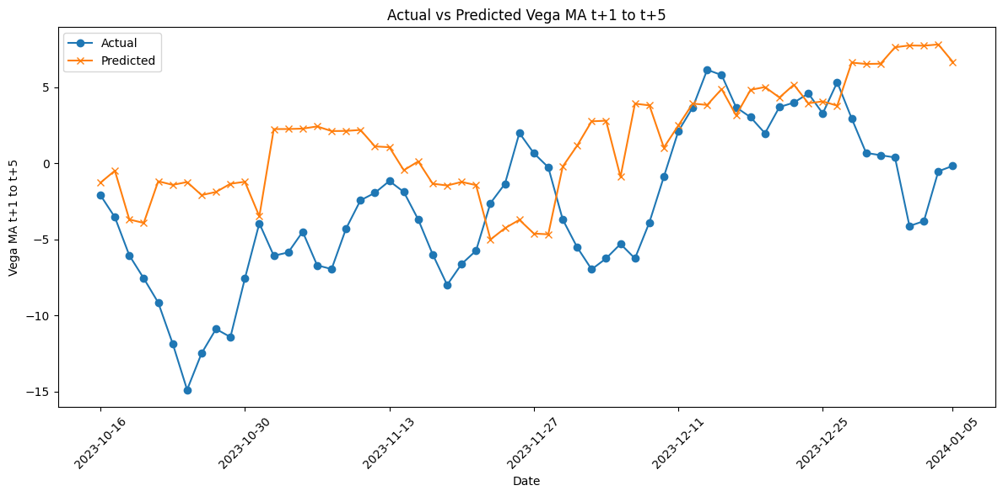
XGBoost - Regression; Product: Expiry 3y Tenor 4y
3
Regression by XGBoost
Actual value: This time series data exhibits a considerable amount of variability, reflecting the inherent fluctuations in the underlying Vega. We observe significant peaks and troughs throughout the given date range, indicating periods of both heightened and reduced Vega levels.
Predicted value:
Generally, the predicted values tend to show a smoother trajectory with fewer extreme peaks and troughs compared to the actual values. The predictions maintain a more moderated range
While the predicted values often follow the general trend of the actual values, they tend to underestimate the magnitude of changes, especially during periods of rapid increases or decreases in the Vega.
This suggests that the model captures the overall trend but struggles with the amplitude of fluctuations.

Slide 17
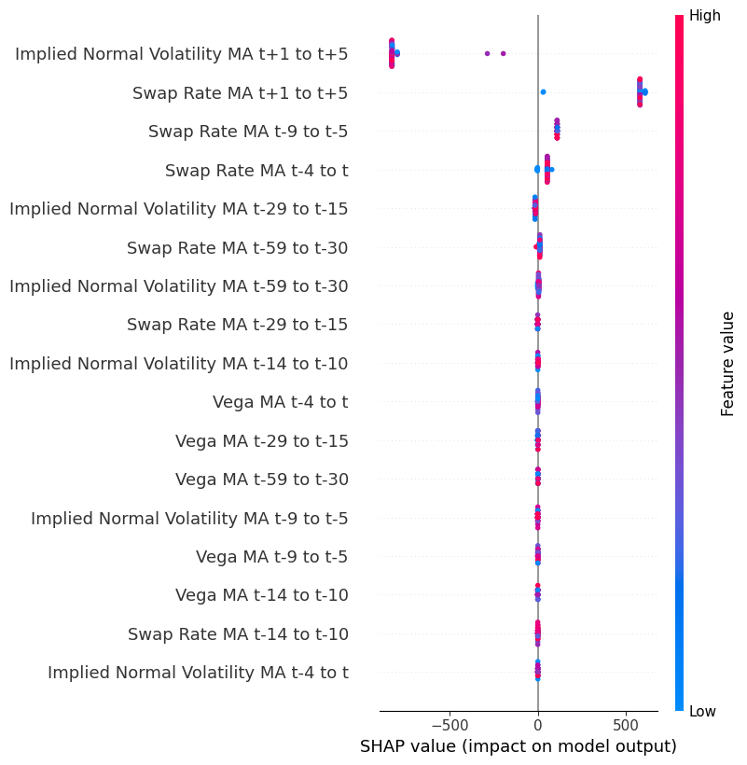
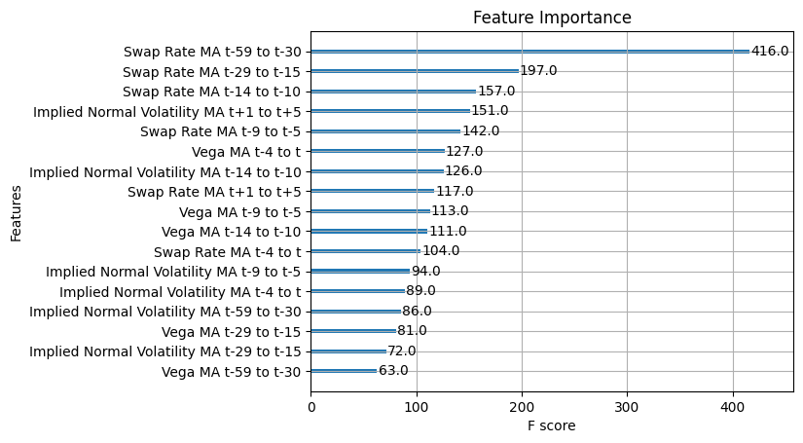
XGBoost - Regression; Product: Expiry 3y Tenor 4y
Expiry 3y Tenor 3y
Mean Squared Error
Mean Absolute Error
124.69
9.27
Expiry 3y Tenor 4y
Mean Squared Error
Mean Absolute Error
38.96
5.19
Same as Expiry 3y Tenor 3y, Swap Rate MA t-59 to t-30 has the highest Feature Importance in the model's predictions.
This demonstrates that, across all Expiry and Tenor terms, historical swap rate data is the most significant factor in shaping the model's outcomes. We emphasize the importance of monitoring swap rate trends for accurate predictions.
Our XGBoost model performs better in predicting Vega for Expiry 3y Tenor 4y contracts, because it exhibits smaller MSE and MAE.
This suggests that even with the same prediction model, its performance can vary across different products
Same as Expiry 3y Tenor 3y, Implied Normal Volatility MA t+1 to t+5 and Swap Rate MA t+1 to t+5 have the strongest impact on model’s prediction.
However, they have reverse +/- impact. This aligns with Expiry 3y Tenor 3y being negatively correlated with Expiry 3y Tenor 4y.

Slide 18
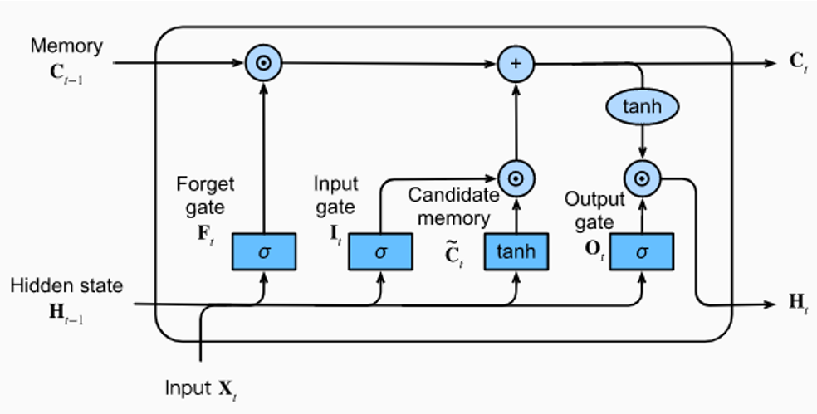

LSTM model
Forget Gate:
Determines whether the model should forget previous memories.
Output Gate:
Determines the output at the current time step.
Input Gate:
Decides how much new information the model should accept at the current time step.
In LSTM model, data such as Swap Rate, Implied Normal Volatility, and Vega from time t-59 to t are treated as parameter inputs to the LSTM model, considering them as time series data
We leverage the LSTM model's capability to capture long-term dependencies in time series data, thereby facilitating more precise risk classification and prediction

Slide 19

LSTM model - Classification; Product: Expiry 3y Tenor 3y
XGBoost
LSTM
They have SIMILAR results!!!

Slide 20
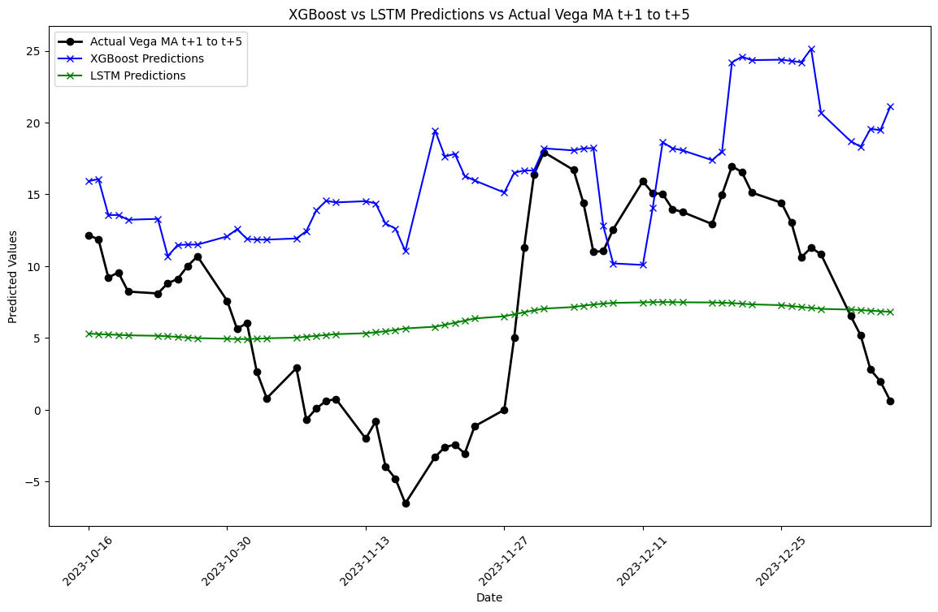
LSTM model - Regression; Product: Expiry 3y Tenor 3y
Mean Squared Error
Mean Absolute Error
XGBoost
124.69
9.27
Mean Squared Error
Mean Absolute Error
LSTM
40.68
5.79
LSTM has smaller MAE and MSE, but it doesn’t look like it captures the trend movement of the actual Vega MA t+1 to t+5

Slide 21
Conclusion
Utilized XGBoost and LSTM to predict future Vega values.
Predictions were made both as a classification (risk buckets) and regression (numerical estimates).
Models trained on historical swap rate, implied normal volatility, and Vega data.
XGBoost offered higher accuracy in classification.
LSTM captured longer-term dependencies for regression.
LSTM showed better performance in numerical predictions with lower MAE and MSE.
Both XGBoost and LSTM fail to capture the trend moments in numerical predictions.
Feature and SHAP analysis show that market Swap Rates and market Implied Normal Volatility significantly impact predicted future Vega values.

Slide 22
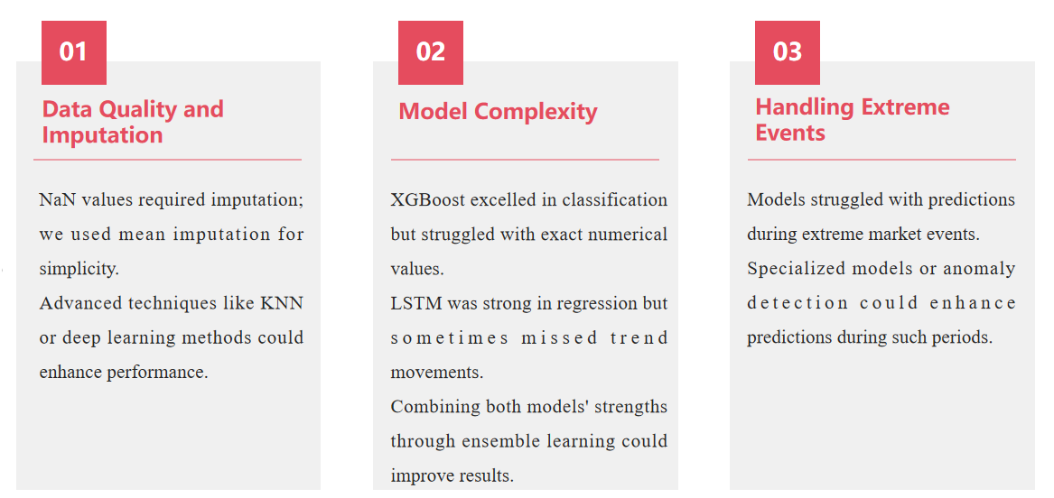
Limitations and Improvements

Slide 23
End
Thank you!

